Slide 1
FINGERPRINT ATTENDANCE SYSTEM USING ESP32
By Raj Parmar (18IT076)
Nikunj Patel (18IT093)
Guided by Prof. Harsh Patel Sir

Slide 2
Overview
Introduction
Project Requirement
What is ESP32 and IFTTT
Circuit Diagram
Working Of Project
Features
Pro’s and Con’s
Conclusion

Slide 3
Introduction
Developed this project using ESP32
You just need ESP32 and Fingerprint sensor to implement.
We will see how our project works in upcoming slides

Slide 4
Requirement
Software Requirement
Arduino IDE
Hardware Requirement
ESP32
Fingerprint sensor
Services Requirement
Wi-fi surrounded zone
IFTTT

Slide 5
What is ESP32 and IFTTT
ESP32 is a series of low-cost, low-power system on a chip microcontrollers with integrated Wi-Fi and dual-mode Bluetooth.
The ESP32 series employs a Tensilica Xtensa LX6 microprocessor in both dual-core and single-core variations and includes built-in antenna switches, RF balun, power amplifier, low-noise receive amplifier, filters, and power-management modules.
ESP32 is created and developed by Espressif Systems, a Shanghai-based Chinese company, and is manufactured by TSMC using their 40 nm process. It is a successor to the ESP8266 microcontroller.

Slide 6
What is ESP32 and IFTTT
If This Then That, also known as IFTTT ,is a free web-based service that creates chains of simple conditional statements, called applets.
An applet is triggered by changes that occur within other web services such as Gmail, Facebook, Telegram, Instagram, or Pinterest.
For example, an applet may send an e-mail message if the user tweets using a hashtag, or copy a photo on Facebook to a user's archive if someone tags a user in a photo.
In addition to the web-based application, the service runs on iOS and Android.
As of 2015, IFTTT users created about 20 million recipes each day. All of the functionalities of the Do suite of apps have since been integrated into a redesigned IFTTT app.
Source : en.wikipedia.org/wiki/IFTTT

Slide 7
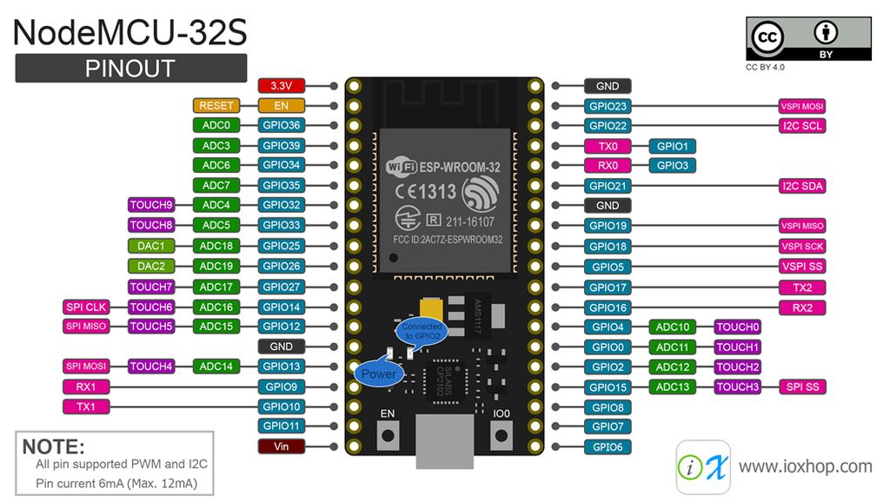
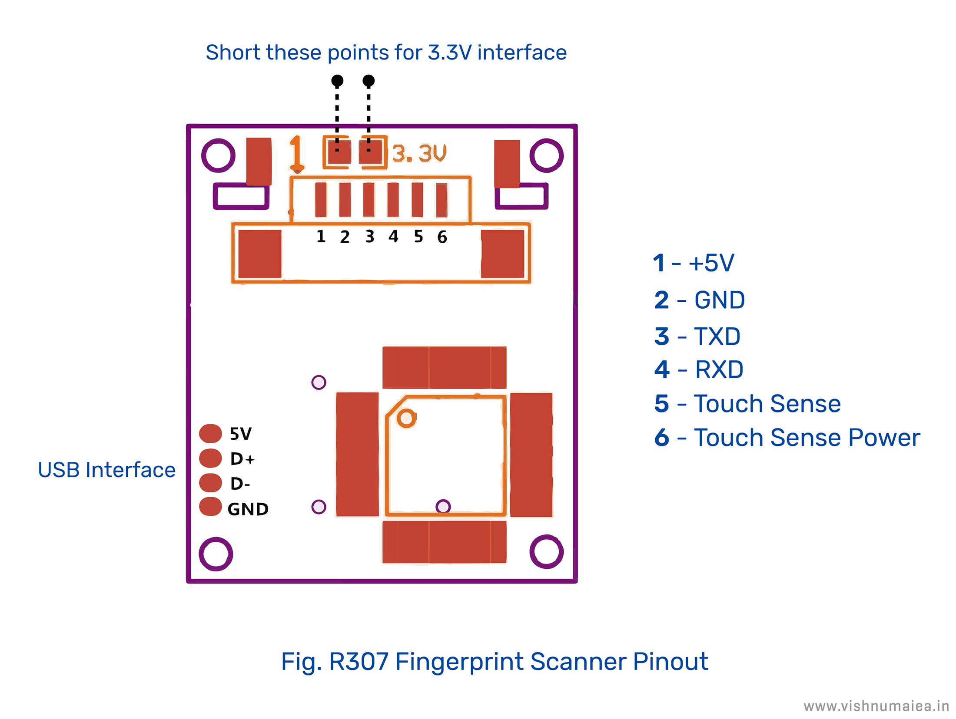
Diagram
ESP32
FINGERPRINT SENSOR
Source : www.google.com

Slide 8
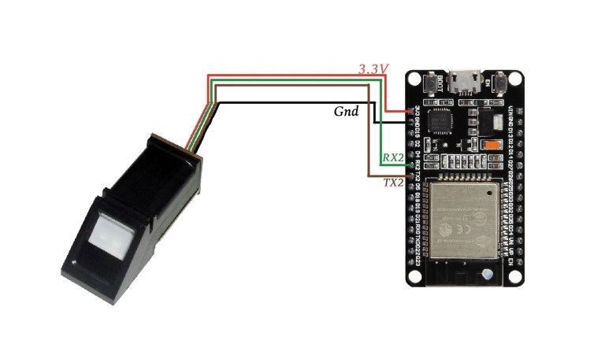
Circuit Diagram
Source : www.google.com

Slide 9
Working
Fingerprint sensor <-> ESP32
We have uploaded the Fingerprints data using ARDUINO IDE
Fingerprints data redirected to IFTTT Portal
IFTTT portal redirectes our data to Google Drive

Slide 10
Features
Unique feature of this project is it takes attendance and directly updates in Google Drive(excel sheet form) online so it is up-to date.
Puts absent/present and based on that displays analysis of individual person and whole class/oﬃce also.

Slide 11
Pro’s and Con’s
Pro’s
Stored directly on database
Build at low cost
Shows up-to-date information
Any one can view at any time
Con’s
If there is lost of wifi connection then we cannot get updated

Slide 12
Conclusion
If this project will used in daily life it will be easier to take the attendance.
And after-all it stores the data directly to the google drive so on need to store the data in our computers etc…

Slide 13
Thank You

